Slide 1
Semester 2 - Speaking Test
Grade 3

Slide 2
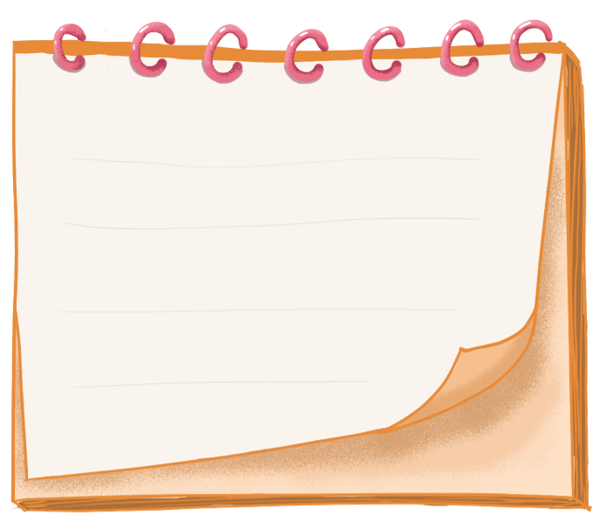
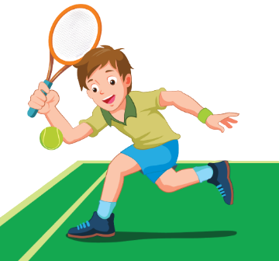
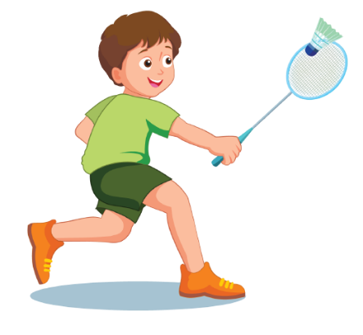
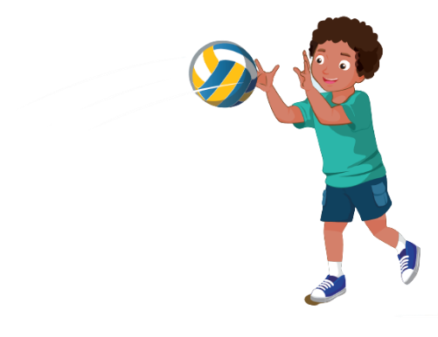
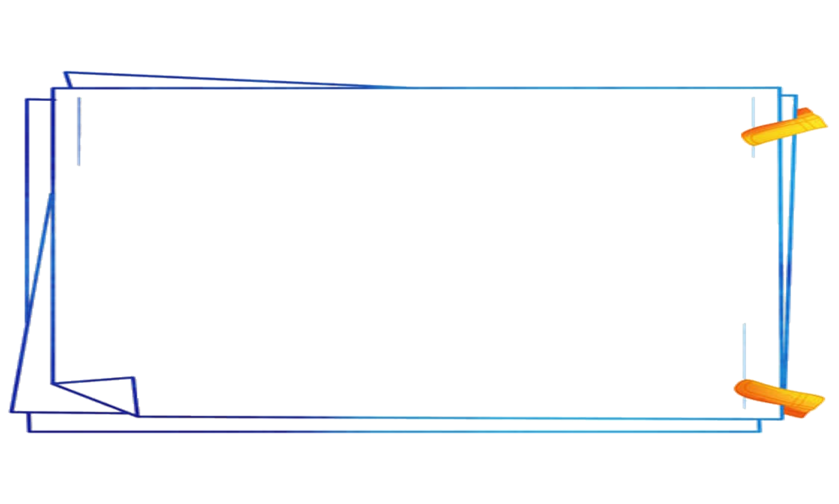

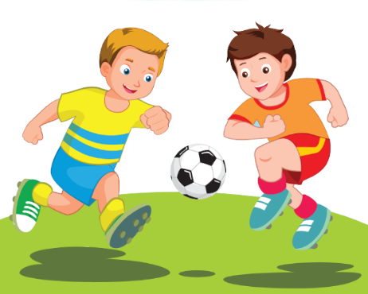
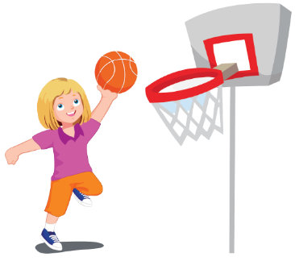
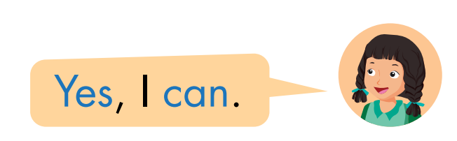

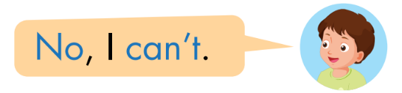
tennis
badminton
basketball
soccer
volleyball
Notes:
It belongs to me Ms Kate. 0964869886.
Face: https://www.facebook.com/huongmoclymc
Group: https://www.facebook.com/groups/mshuong

Slide 3


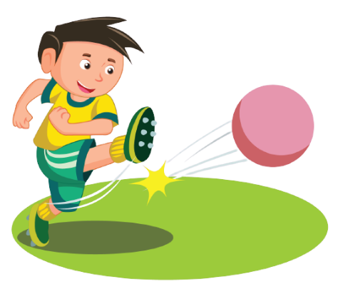
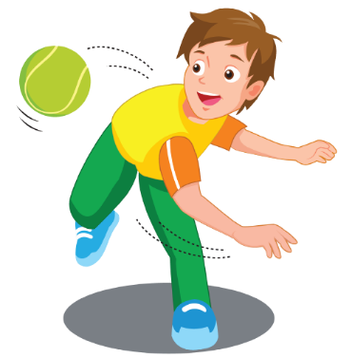

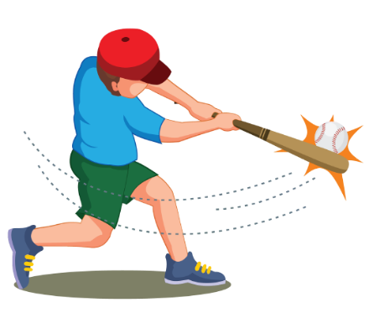

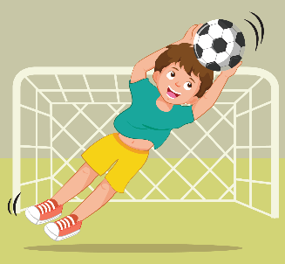

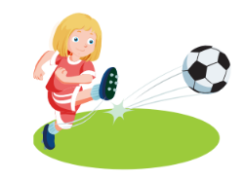
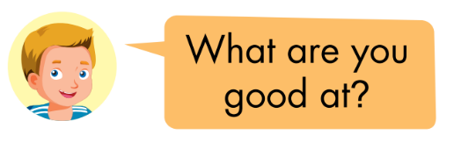
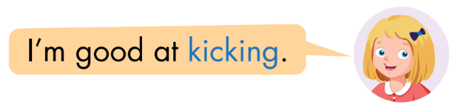
throwing
kicking
hitting
catching
Notes:
It belongs to me Ms Kate. 0964869886.
Face: https://www.facebook.com/huongmoclymc
Group: https://www.facebook.com/groups/mshuong

Slide 4

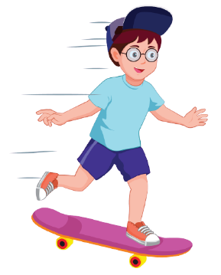
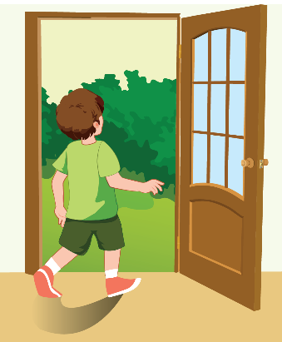
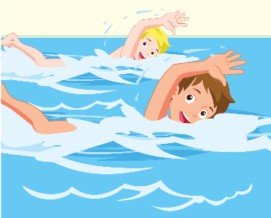

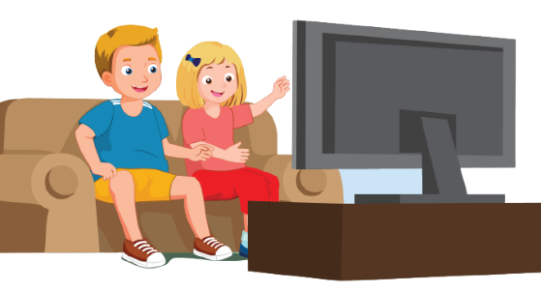
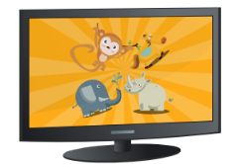
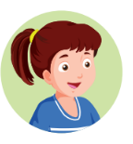

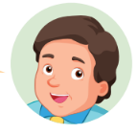

go
skateboarding
go out
go swimming
watch TV
May I watch TV ?
Yes, you may.
No, you may not.
Notes:
It belongs to me Ms Kate. 0964869886.
Face: https://www.facebook.com/huongmoclymc
Group: https://www.facebook.com/groups/mshuong

Slide 5
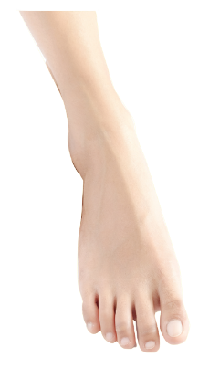
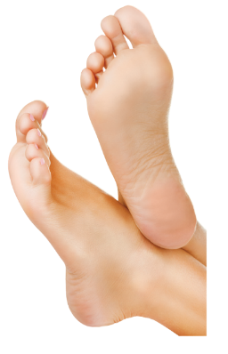
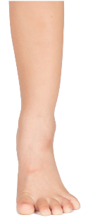
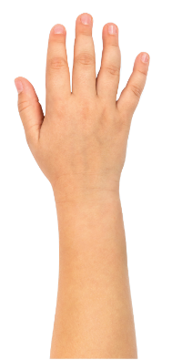
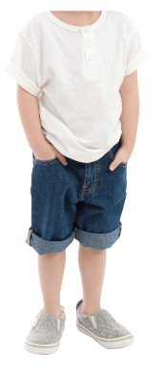
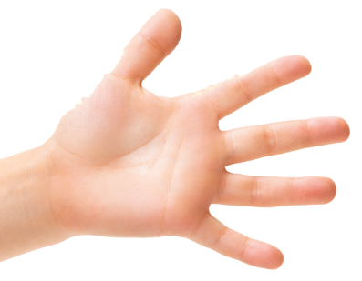
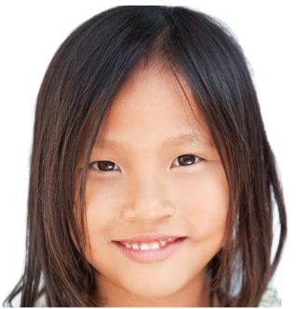
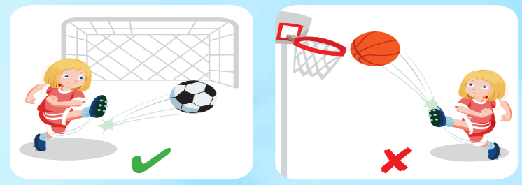
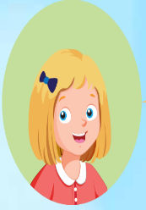
foot
feet
leg
body
arm
hand
head
I use my legs and feet in soccer.
I can kick the ball in soccer.
I can't kick the ball in basketball.
Notes:
It belongs to me Ms Kate. 0964869886.
Face: https://www.facebook.com/huongmoclymc
Group: https://www.facebook.com/groups/mshuong

Slide 6



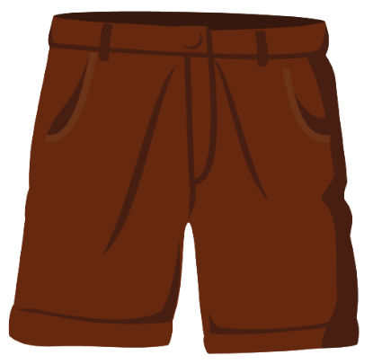
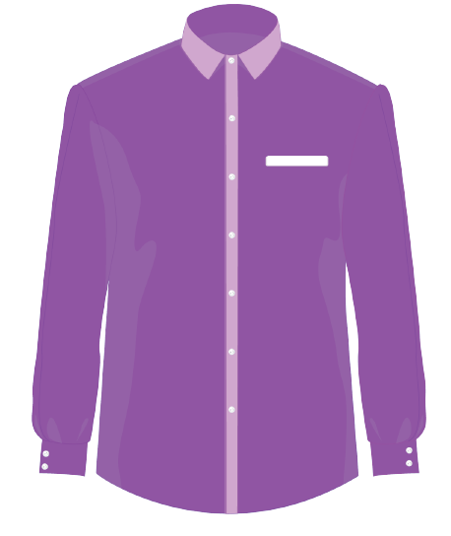

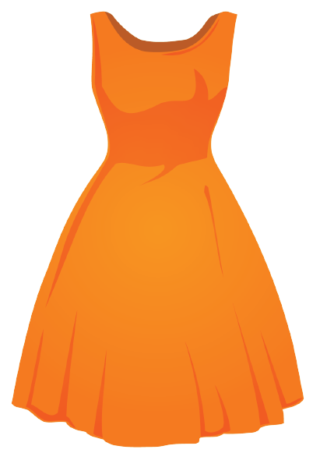
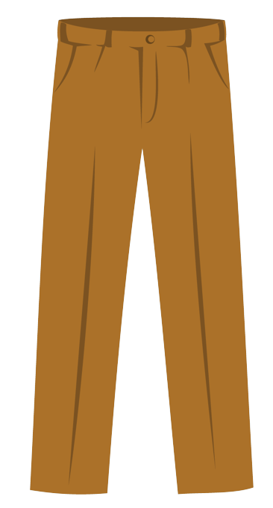
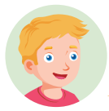

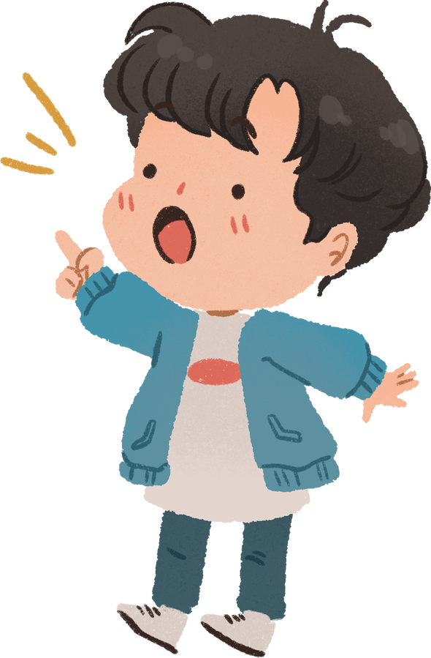


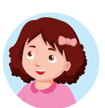

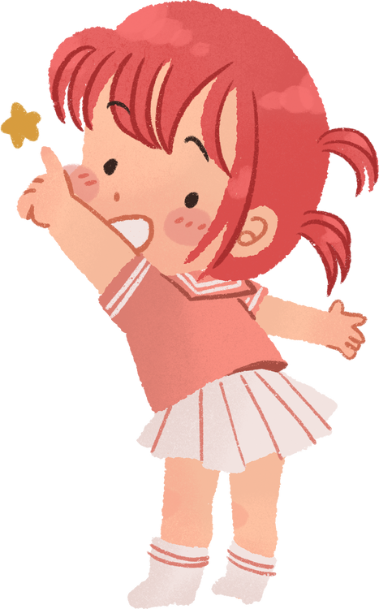






shorts
socks
shirt
pants
dress
Notes:
It belongs to me Ms Kate. 0964869886.
Face: https://www.facebook.com/huongmoclymc
Group: https://www.facebook.com/groups/mshuong

Slide 7

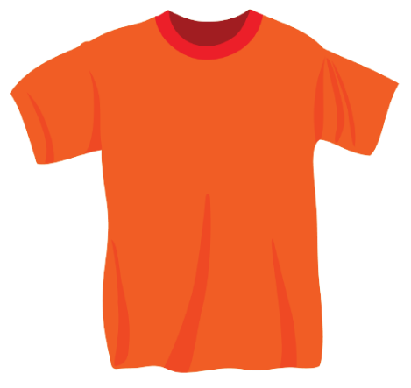
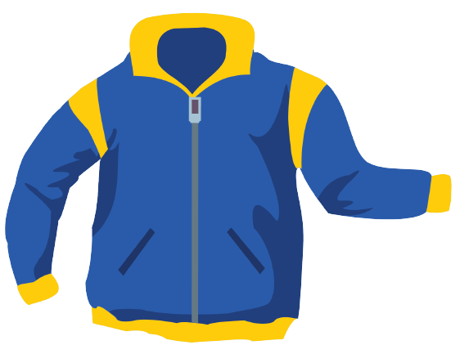
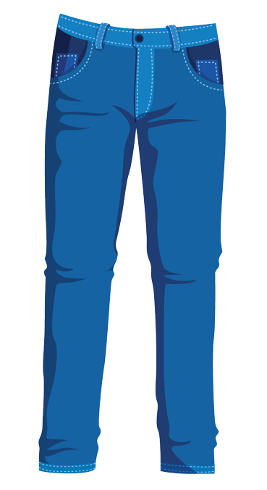


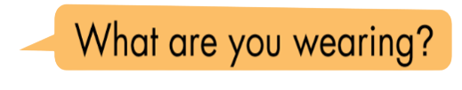
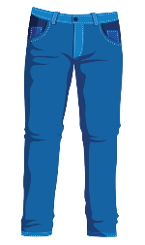

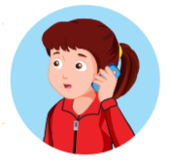
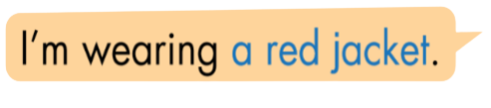
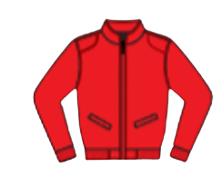
skirt
jacket
T-shirt
boots
jeans
Notes:
It belongs to me Ms Kate. 0964869886.
Face: https://www.facebook.com/huongmoclymc
Group: https://www.facebook.com/groups/mshuong

Slide 8
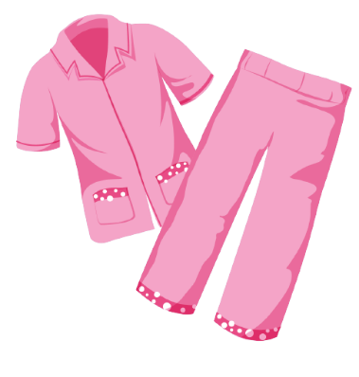
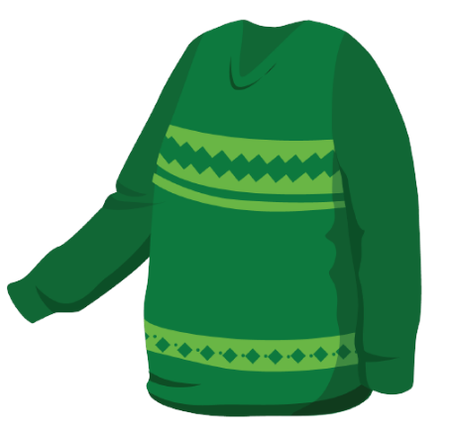







pajamas
scarf
sweater
belt
skiing
Is that your belt?
Yes, it is.
No, it isn’t.
Yes, they are.
Are those your pajamas?
No, they aren’t.
Notes:
It belongs to me Ms Kate. 0964869886.
Face: https://www.facebook.com/huongmoclymc
Group: https://www.facebook.com/groups/mshuong

Slide 9










polo shirt
shoes
tie
uniform
Notes:
It belongs to me Ms Kate. 0964869886.
Face: https://www.facebook.com/huongmoclymc
Group: https://www.facebook.com/groups/mshuong

Slide 10












big
small
robot
car
doll
Notes:
It belongs to me Ms Kate. 0964869886.
Face: https://www.facebook.com/huongmoclymc
Group: https://www.facebook.com/groups/mshuong

Slide 11












card
block
dice
marble
Notes:
It belongs to me Ms Kate. 0964869886.
Face: https://www.facebook.com/huongmoclymc
Group: https://www.facebook.com/groups/mshuong

Slide 12









under
on
in
toy box
wardrobe
Notes:
It belongs to me Ms Kate. 0964869886.
Face: https://www.facebook.com/huongmoclymc
Group: https://www.facebook.com/groups/mshuong

Slide 13
















eleven
twelve
thirteen
fourteen
fifteen
sixteen
seventeen
eighteen
nineteen
twenty
Notes:
It belongs to me Ms Kate. 0964869886.
Face: https://www.facebook.com/huongmoclymc
Group: https://www.facebook.com/groups/mshuong

Slide 14









carrot
banana
cupcake
donut
There is an apple .
There is a banana .
There are eight cupcakes .
apple
Notes:
It belongs to me Ms Kate. 0964869886.
Face: https://www.facebook.com/huongmoclymc
Group: https://www.facebook.com/groups/mshuong

Slide 15







tomato
egg
onion
lime
Are there any tomatoes?
- Yes, there are.
- No, there aren’t.
Is there an onion?
- Yes, there is.
potato
- No, there isn’t.
Notes:
It belongs to me Ms Kate. 0964869886.
Face: https://www.facebook.com/huongmoclymc
Group: https://www.facebook.com/groups/mshuong

Slide 16













cake
ice cream
pizza
fries
chicken
Would you like some fries?
Yes, please.
Sure, thanks!
Would you like some cakes?
fish
No, thank you.
Notes:
It belongs to me Ms Kate. 0964869886.
Face: https://www.facebook.com/huongmoclymc
Group: https://www.facebook.com/groups/mshuong

Slide 17








fork
spoon
knife
chopsticks
We eat ice cream with a spoon .
We often eat chicken.
noodles
My favorite food is fish .
Notes:
It belongs to me Ms Kate. 0964869886.
Face: https://www.facebook.com/huongmoclymc
Group: https://www.facebook.com/groups/mshuong

