Slide 1
Semester 2 - Speaking Test
Grade 5

Slide 2


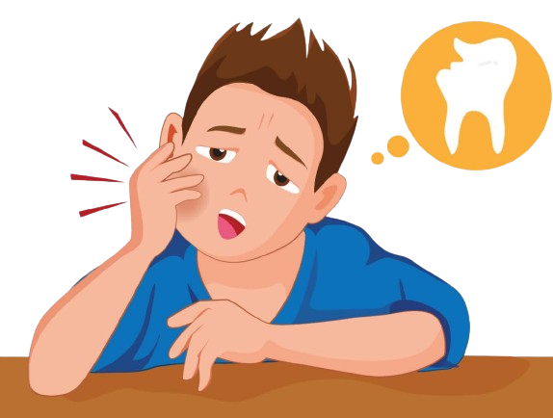
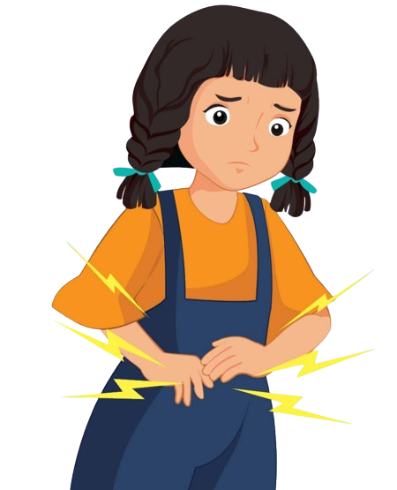
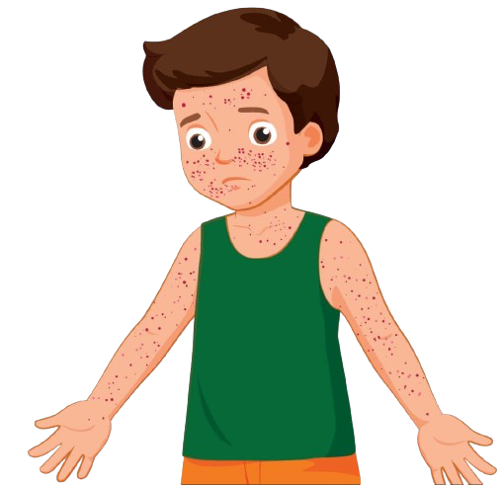

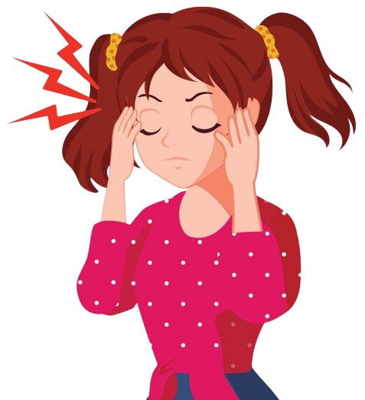




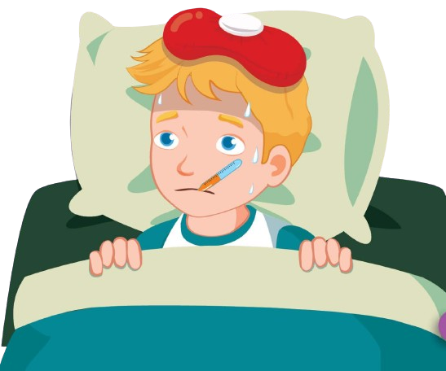
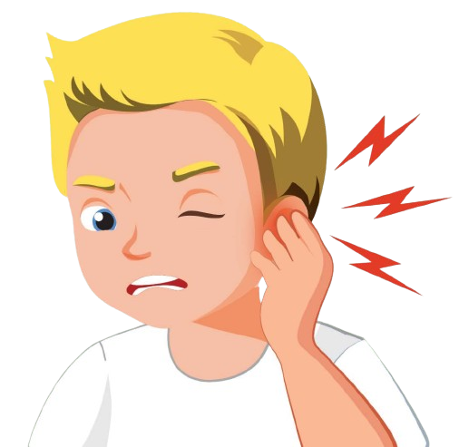

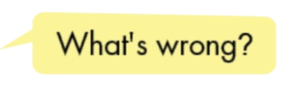
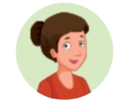
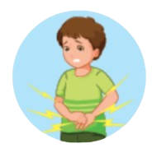
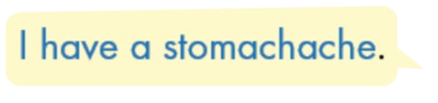




Unit 5: Health
Notes:
It belongs to me Ms Kate. 0964869886.
Face: https://www.facebook.com/huongmoclymc
Group: https://www.facebook.com/groups/mshuong

Slide 3
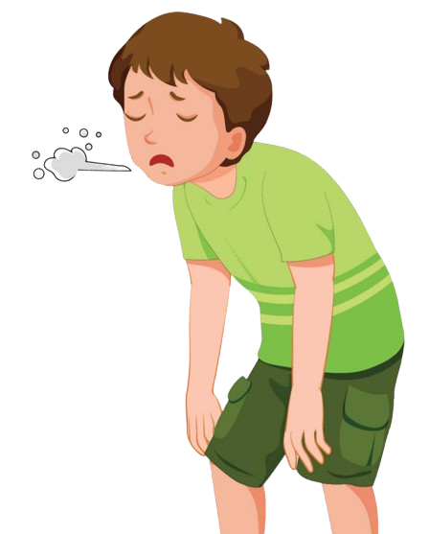
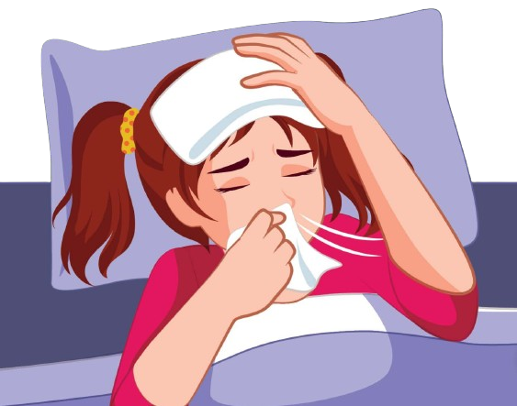
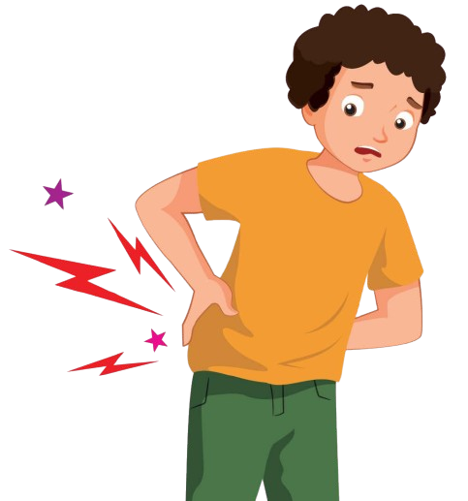
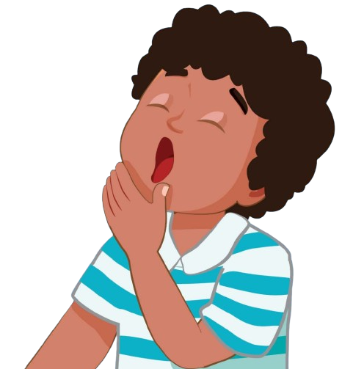




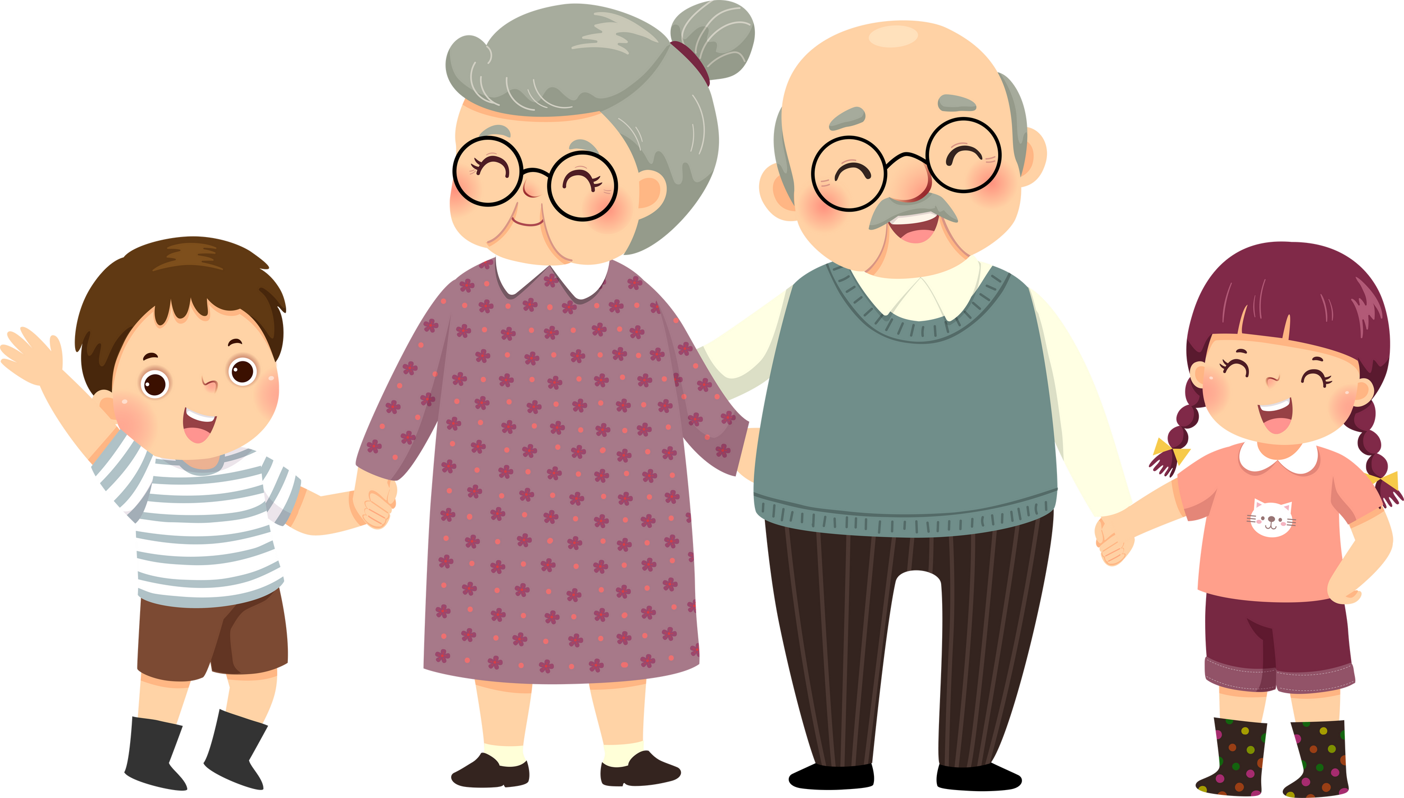



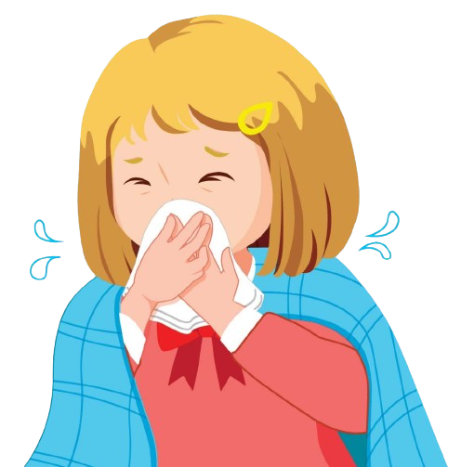


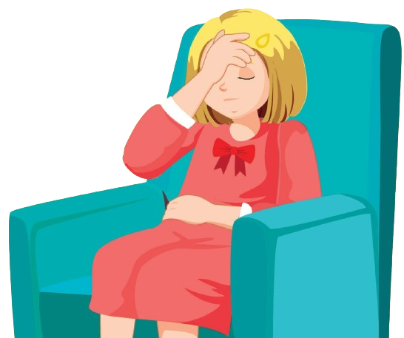
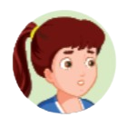
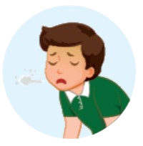






I
Unit 5: Health
Notes:
It belongs to me Ms Kate. 0964869886.
Face: https://www.facebook.com/huongmoclymc
Group: https://www.facebook.com/groups/mshuong

Slide 4

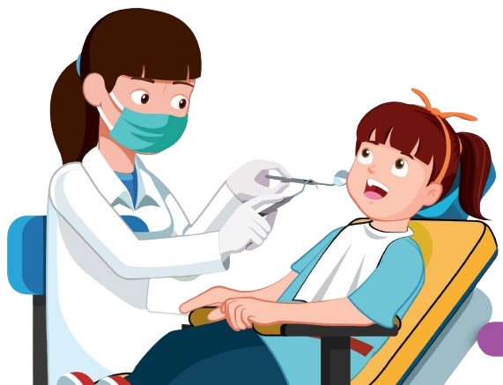
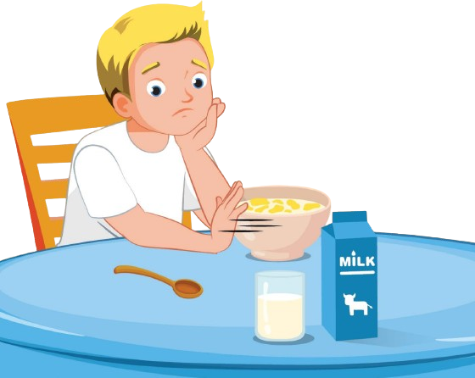
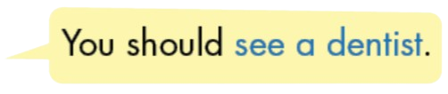
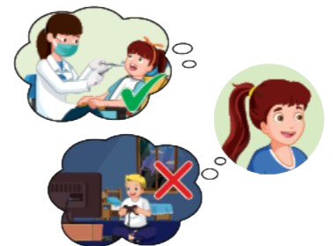

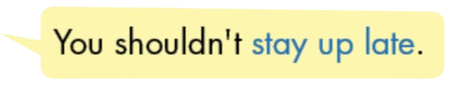

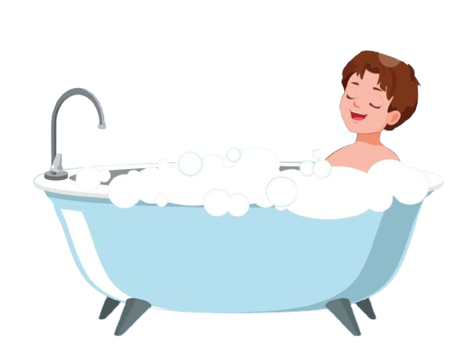





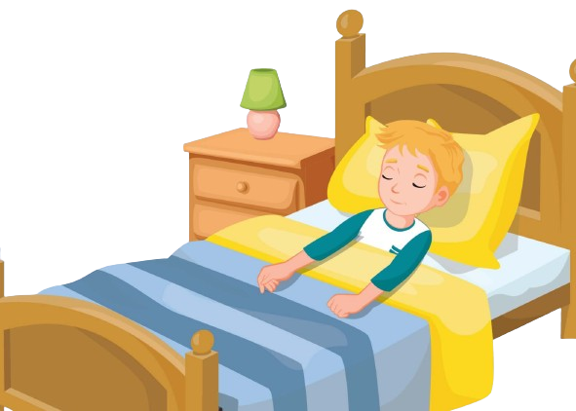




He
Unit 5: Health
Notes:
It belongs to me Ms Kate. 0964869886.
Face: https://www.facebook.com/huongmoclymc
Group: https://www.facebook.com/groups/mshuong

Slide 5
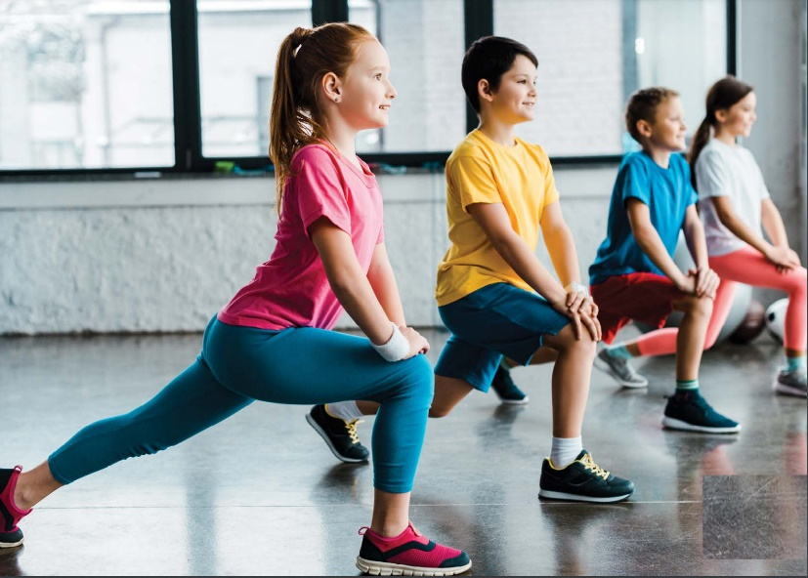
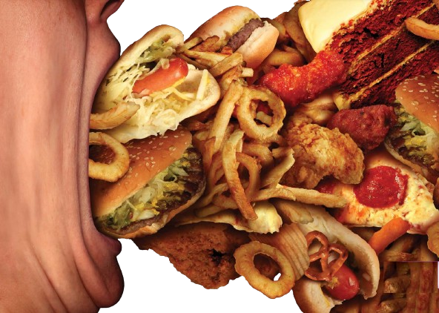






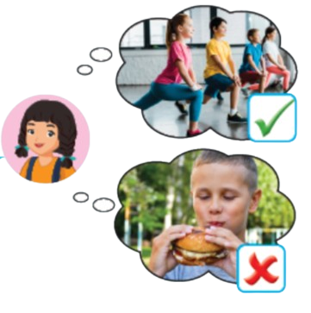
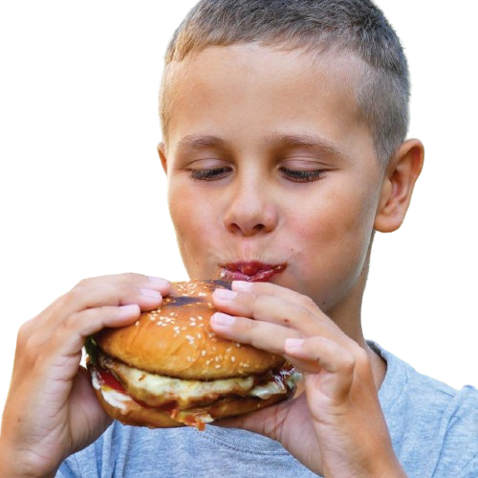

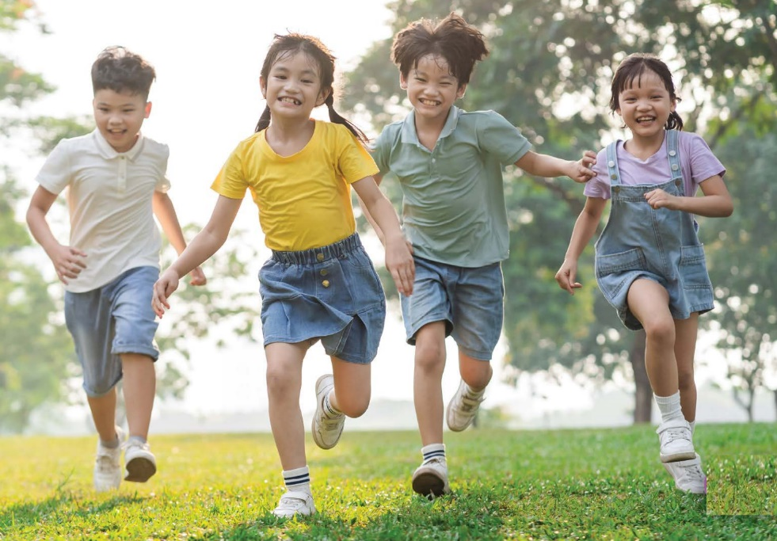
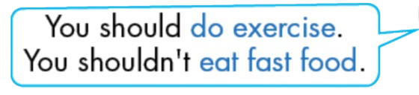

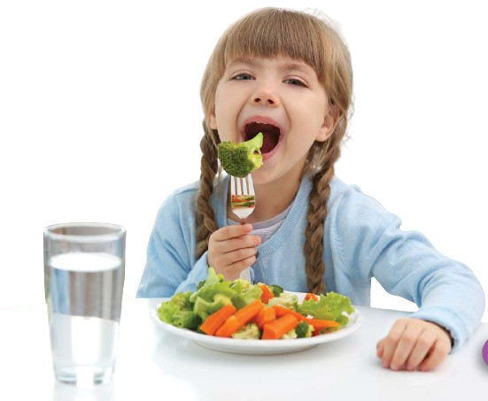

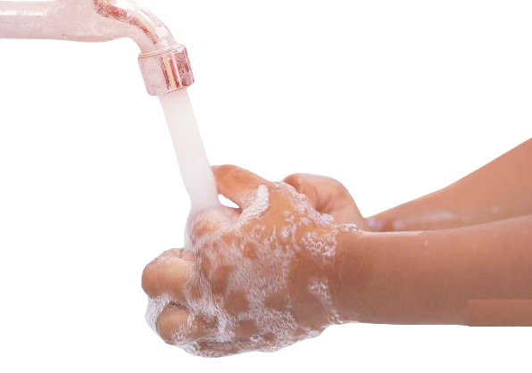


Unit 5: Health
Notes:
It belongs to me Ms Kate. 0964869886.
Face: https://www.facebook.com/huongmoclymc
Group: https://www.facebook.com/groups/mshuong

Slide 6
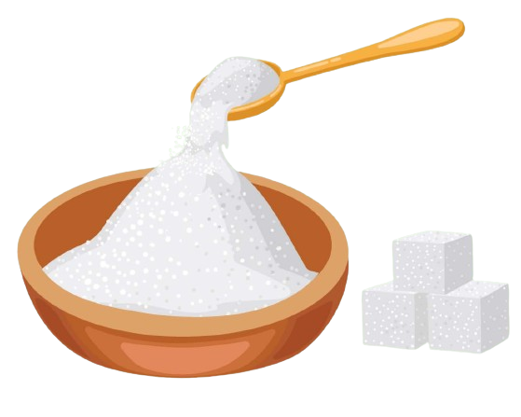

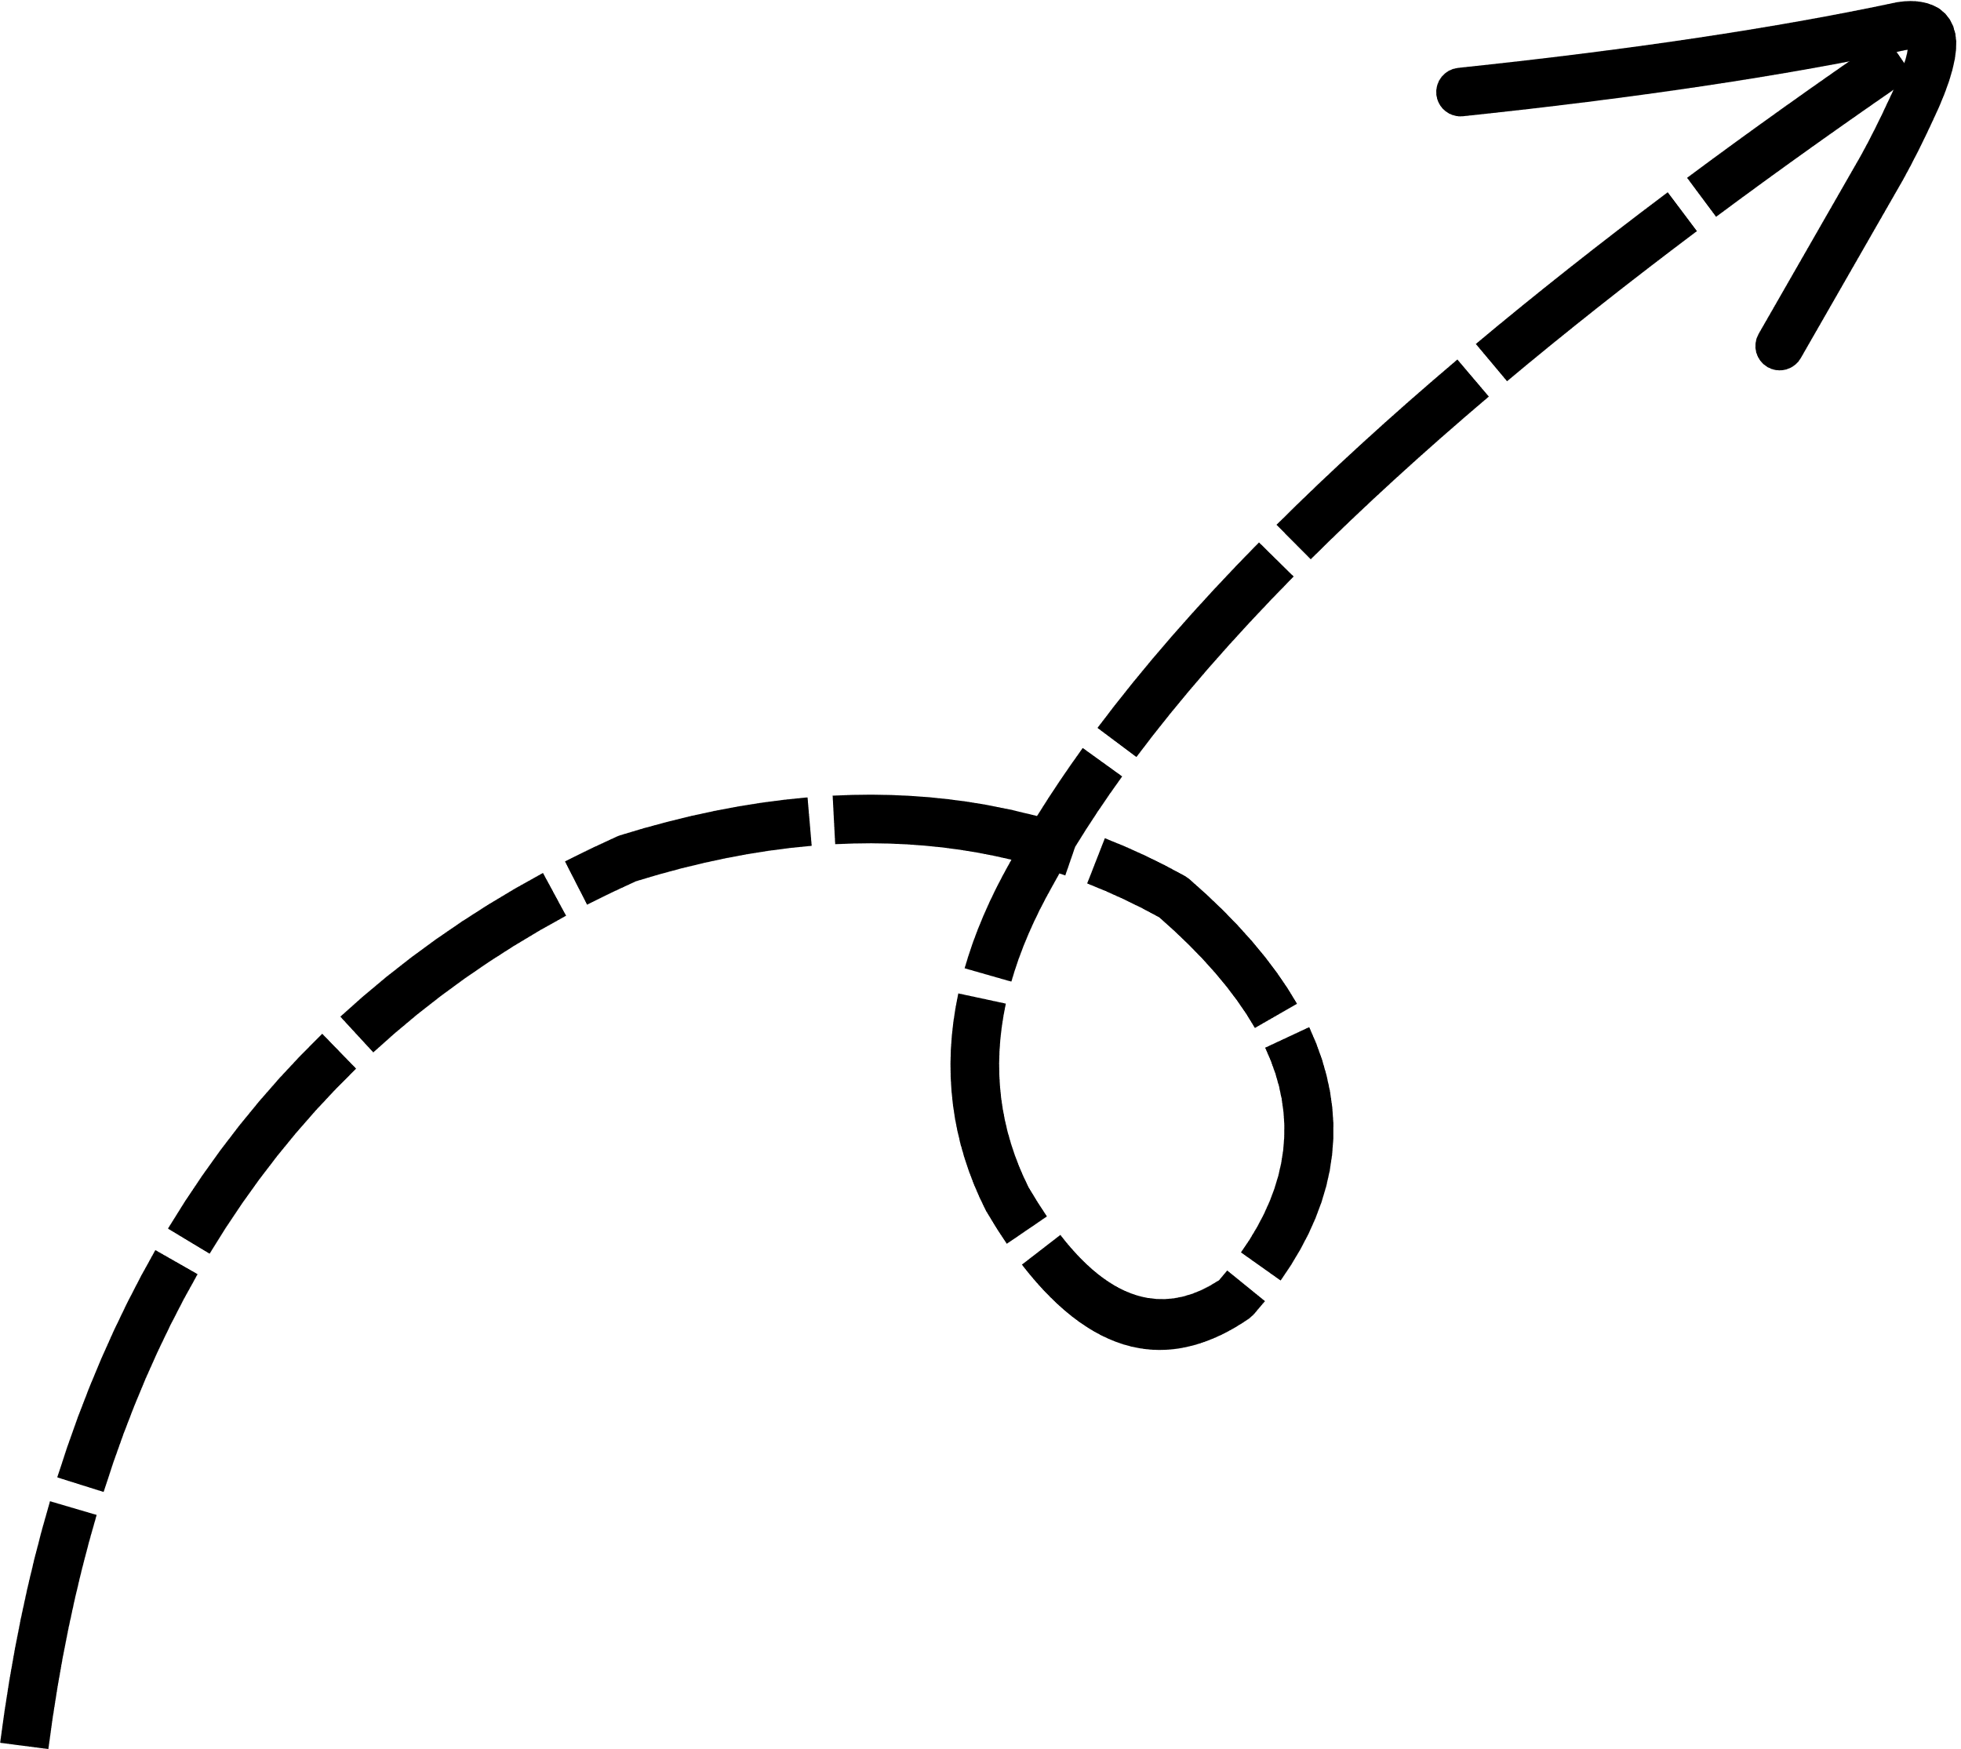
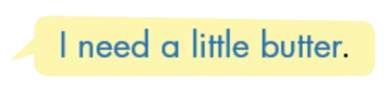



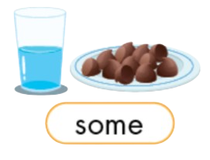


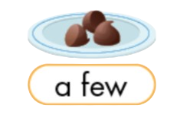

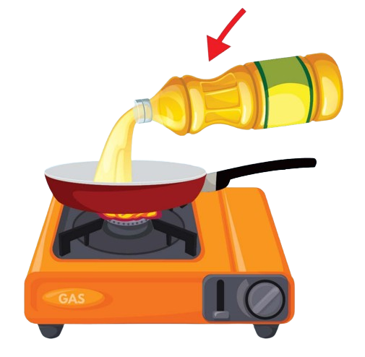






We
She
She
I
They
He
Unit 6: Food and drinks
Notes:
It belongs to me Ms Kate. 0964869886.
Face: https://www.facebook.com/huongmoclymc
Group: https://www.facebook.com/groups/mshuong

Slide 7


















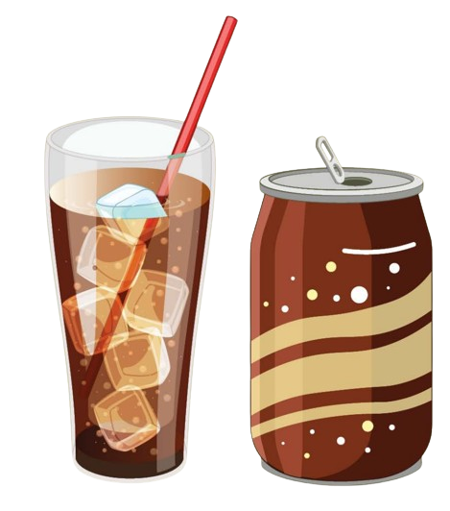


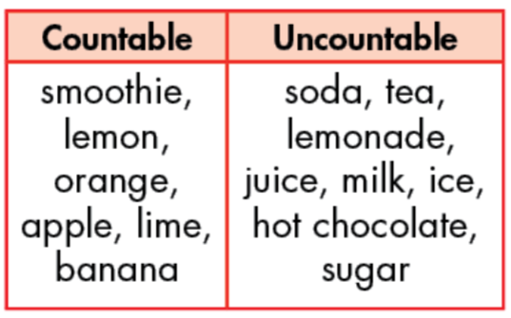
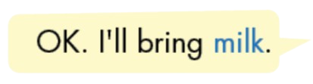

Unit 6: Food and drinks
Notes:
It belongs to me Ms Kate. 0964869886.
Face: https://www.facebook.com/huongmoclymc
Group: https://www.facebook.com/groups/mshuong

Slide 8

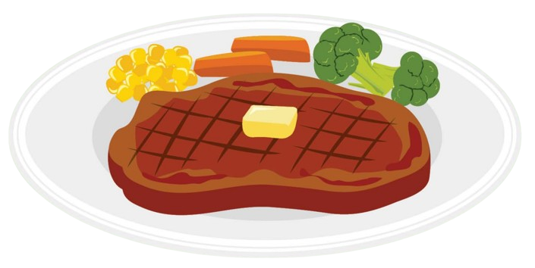




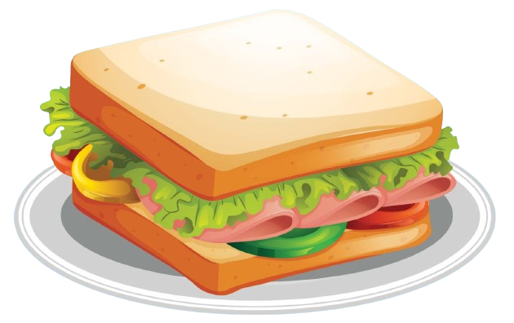




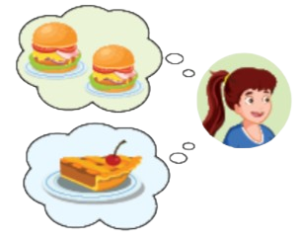

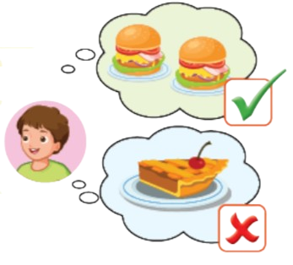


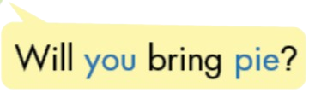

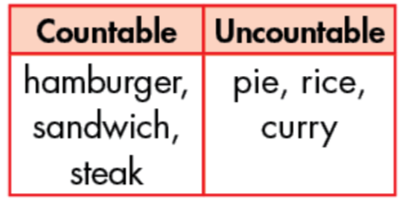
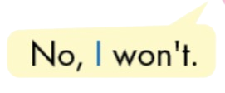

Unit 6: Food and drinks
Notes:
It belongs to me Ms Kate. 0964869886.
Face: https://www.facebook.com/huongmoclymc
Group: https://www.facebook.com/groups/mshuong

Slide 9





























Unit 6: Food and drinks
Notes:
It belongs to me Ms Kate. 0964869886.
Face: https://www.facebook.com/huongmoclymc
Group: https://www.facebook.com/groups/mshuong

Slide 10

















Unit 7: Jobs
Notes:
It belongs to me Ms Kate. 0964869886.
Face: https://www.facebook.com/huongmoclymc
Group: https://www.facebook.com/groups/mshuong

Slide 11















He-
movie
He-
helping people
You-sports
He-
cars
You-helping sick people
I-
singing
Unit 7: Jobs
Notes:
It belongs to me Ms Kate. 0964869886.
Face: https://www.facebook.com/huongmoclymc
Group: https://www.facebook.com/groups/mshuong

Slide 12

















You
You
You
You
He
She
Unit 7: Jobs
Notes:
It belongs to me Ms Kate. 0964869886.
Face: https://www.facebook.com/huongmoclymc
Group: https://www.facebook.com/groups/mshuong

Slide 13
















Unit 7: Jobs
Notes:
It belongs to me Ms Kate. 0964869886.
Face: https://www.facebook.com/huongmoclymc
Group: https://www.facebook.com/groups/mshuong

Slide 14






























He
He
I
We
I
He
Unit 8: Weather
Notes:
It belongs to me Ms Kate. 0964869886.
Face: https://www.facebook.com/huongmoclymc
Group: https://www.facebook.com/groups/mshuong

Slide 15





























Unit 8: Weather
Notes:
It belongs to me Ms Kate. 0964869886.
Face: https://www.facebook.com/huongmoclymc
Group: https://www.facebook.com/groups/mshuong

Slide 16





















Unit 8: Weather
Notes:
It belongs to me Ms Kate. 0964869886.
Face: https://www.facebook.com/huongmoclymc
Group: https://www.facebook.com/groups/mshuong

Slide 17




















Paris
Paris
Paris
Paris
Unit 8: Weather
Notes:
It belongs to me Ms Kate. 0964869886.
Face: https://www.facebook.com/huongmoclymc
Group: https://www.facebook.com/groups/mshuong

