Slide 1
SỞ GIÁO DỤC VÀ ĐÀO TẠO NINH BÌNH
CUỘC THI THIẾT KẾ BÀI GIẢNG E-LEARNING
UNIT 8: FOOD – LESSON 1
Bộ môn: Tiếng anh – Lớp 3
Tác giả: Nguyễn Thị Thùy Trang
Email: nguyentrang81094@gmail.com
Đơn vị công tác: Trường Tiểu học Vĩnh Hào, xã Liên Minh tỉnh Ninh Bình

Slide 2

Unit 8: Food
Lesson 1.1
Page 110

Slide 3
Objectives
By the end of this lesson, students will be able to…
Vocabulary: Pronounce and use the words related to the topic properly: apple, banana, carrot, cupcake, donut
Structure: Use There is an apple/There is a banana/There are eight cupcakes.

Slide 4

Presentation

Slide 5
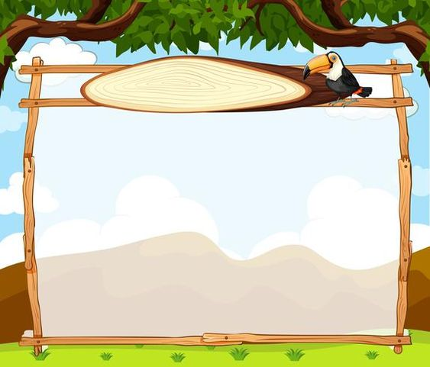

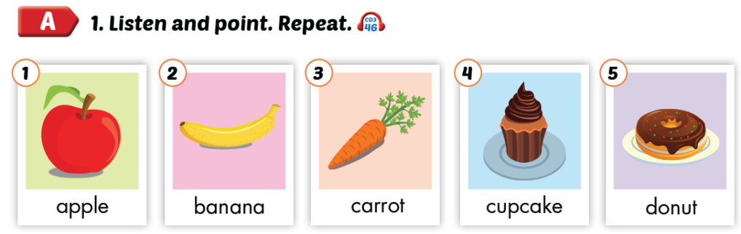

Slide 6
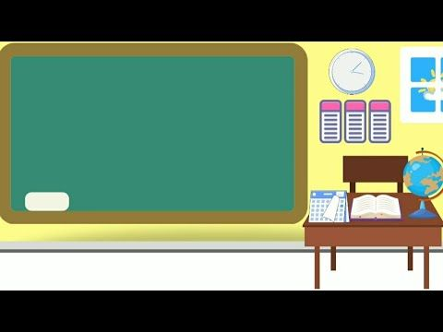

apple

Slide 7
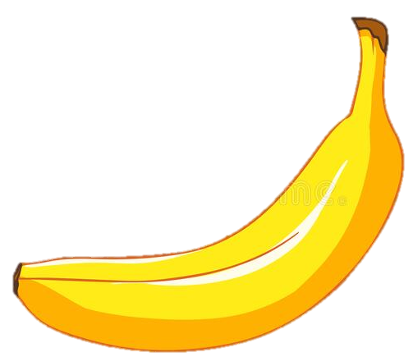
banana

Slide 8
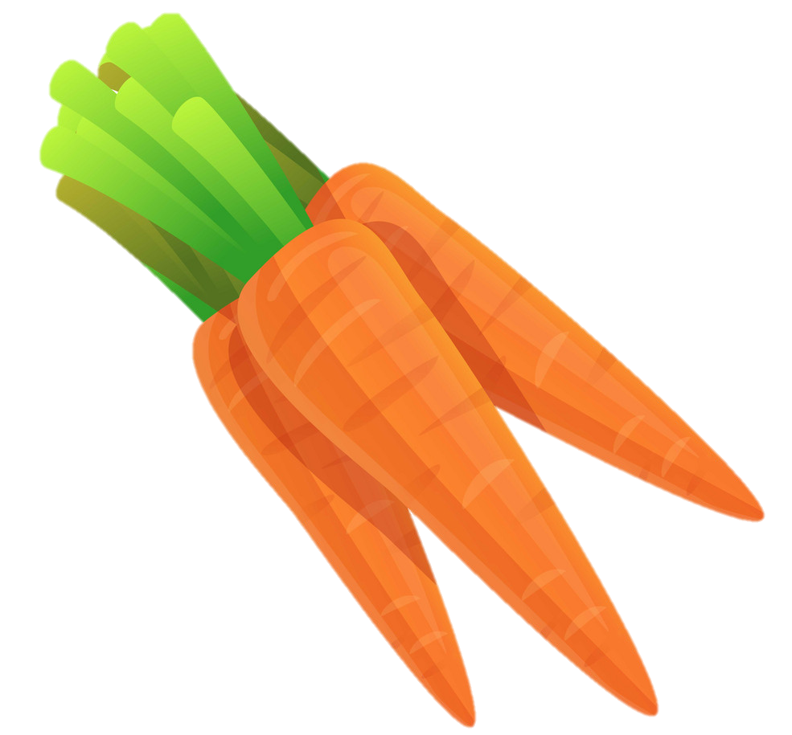
Carrots

Slide 9

cupcake

Slide 10
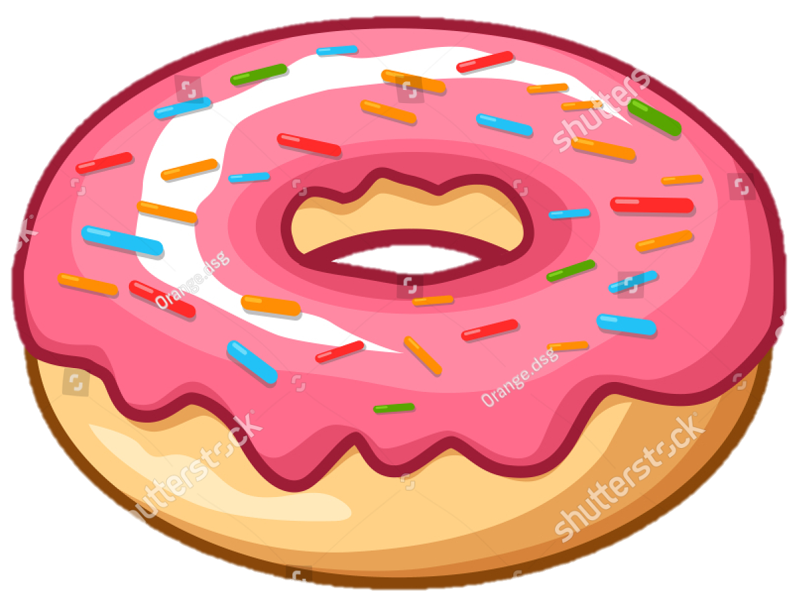
donut

Slide 11
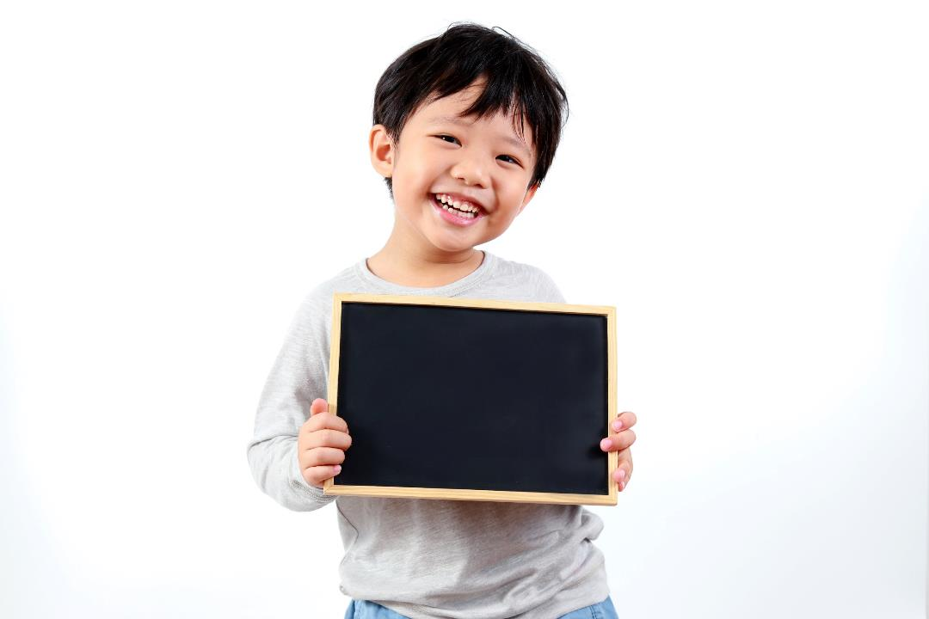
Practice

Slide 12
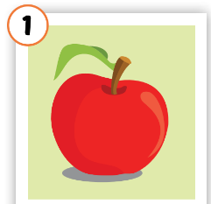
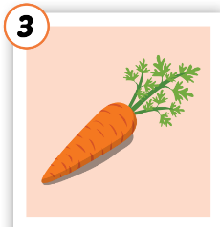
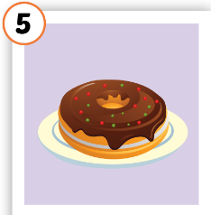
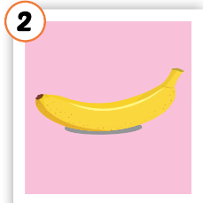
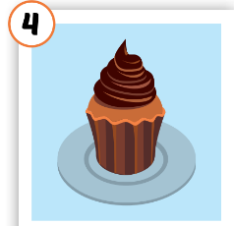
LOOK AND WRITE
o
carr_t
n
do_ut
e
appl_
b
_anana
c_pcake
u

Slide 13
Let’s find
the food!
c
u
p
c
a
k
e
a
p
p
l
e
t
e
b
a
n
a
n
a
a
c
a
r
r
o
t
c
Click on the first letter of each word to see the name of food
d
o
n
u
t
u
u

Slide 14
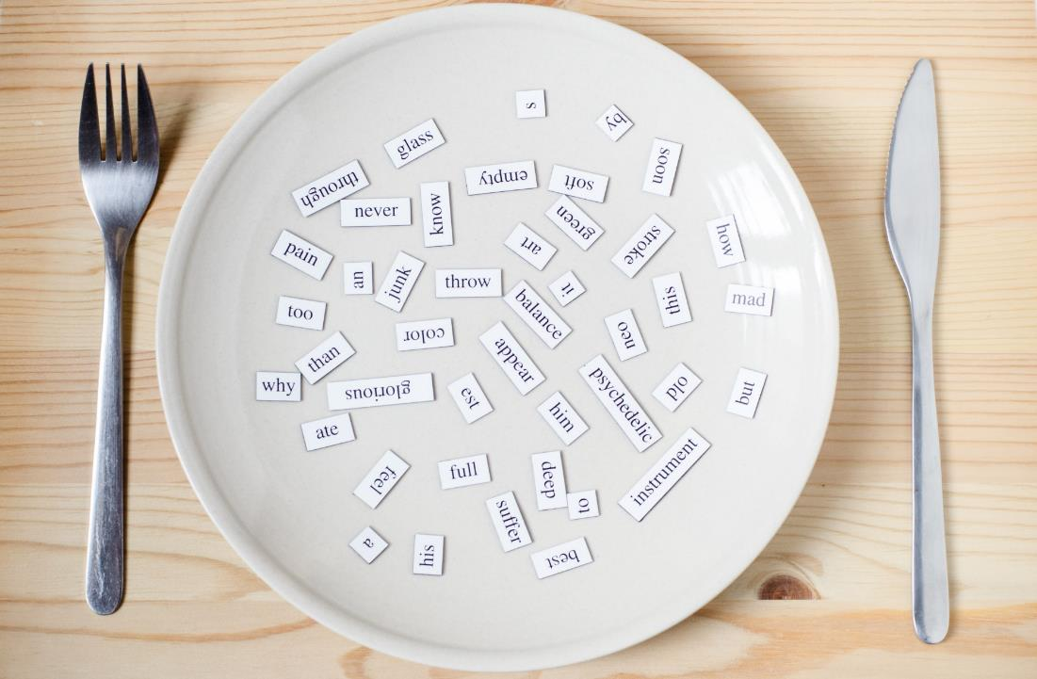
Structures
There is an apple.
There is a banana. There are eight cupcakes.

Slide 15
Presentation

Slide 16


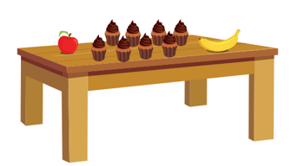
There is an apple.
There is a banana.
There are eight cupcakes.
Click on each sentence to listen

Slide 17
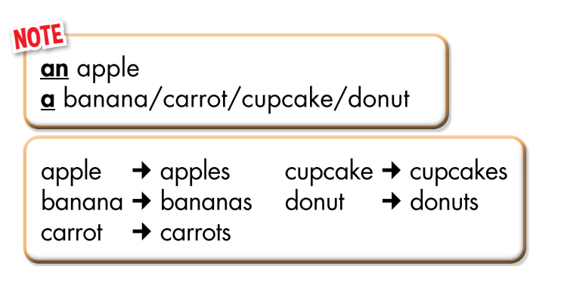

Slide 18
Practice

Slide 19

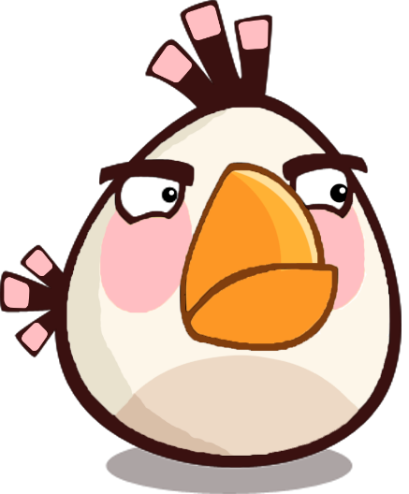
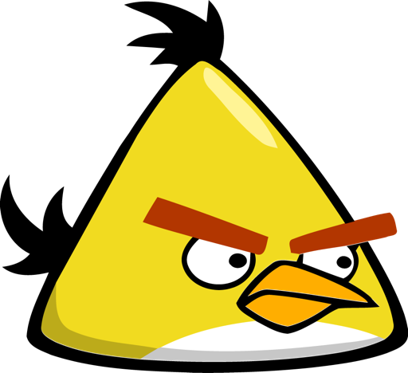

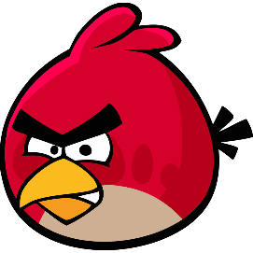

PLAY
There is – there are

Slide 20


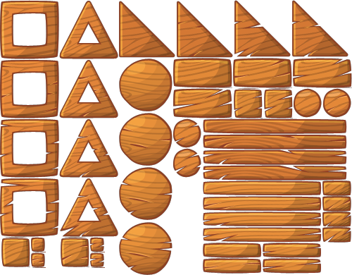
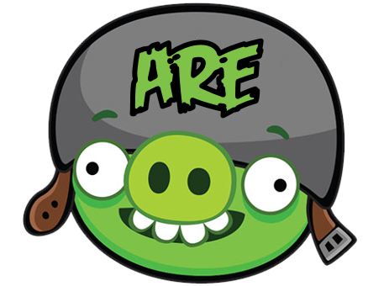



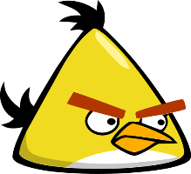
is
There an apple under the chair.

Slide 21
is
There an orange in the fridge.

Slide 22


There two carrots in the kitchen
are

Slide 23
There some cupcakes in the dining room.
are

Slide 24
is
There a donut in the box.

Slide 25

There a banana on the table.
is

Slide 26


There any bananas.
aren’t

Slide 27
isn’t
There a cupcake on the desk.

Slide 28
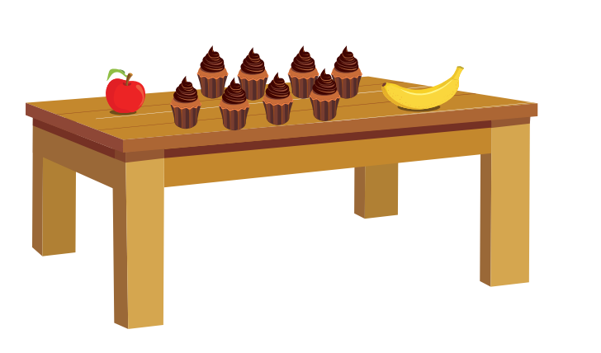
Describe the picture
Structures/ Sentence patterns
There is a/an………………..
There are ………………………..

Slide 29
Lesson 3
Today’s lesson
Vocabularies
apple, banana, carrot, cupcake, donut
Structures/ Sentence patterns
There is an apple/There is a banana/There are eight cupcakes.

Slide 30

THANK YOU!
Welcome to join with me!

